Slide 1
RED NEURONAL

Slide 2
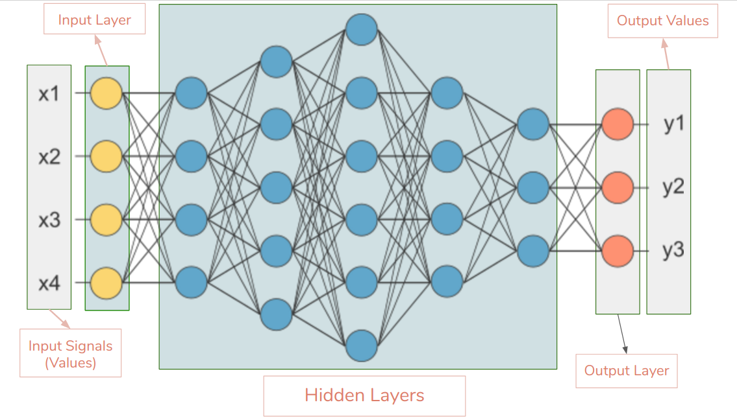
FORWARD
backward

Slide 3

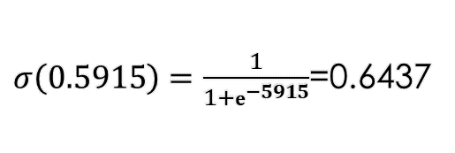

Forward propagation
$$σ\left(\sum_{i=0}{w_{i}}⋅v_{i}\right)$$
$$σ\left(x\right)=\frac{1}{1+ⅇ^{−x}}$$
0.49
0.15
0.7
0.5
0.643
0.21*0.8+0.7*0.5+0.49*0.15=0.5915
0.8
$σ\left(0.5915\right)=\frac{1}{1+ⅇ^{−5915}}$=0.6437
0.21

Slide 4
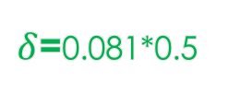
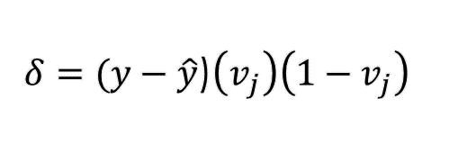
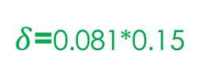
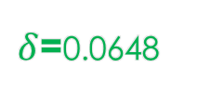
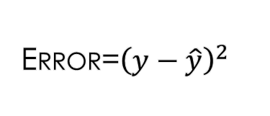
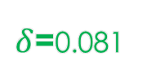
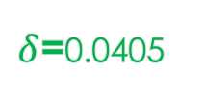
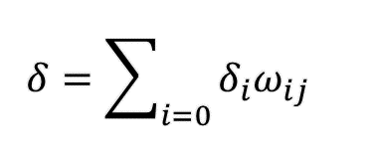
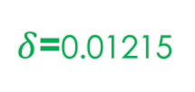
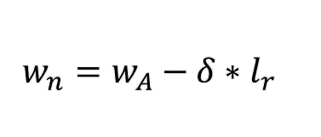
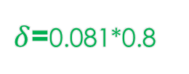
BACKWARD PROPAGATION
Error=${\left(y−\hat{y}\right)}^{2}$
$δ=(y−\hat{y}$)$\left(v_{j}\right)\left(1−v_{j}\right)$
$δ$=0.081*0.15
0.49
$δ$=0.01215
0.15
0.13
0.15-Lr(0.081*0.49)
$δ=\sum_{i=0}{δ_{i}ω_{ij}}$
$δ$=0.081
0.5
0.7
0.47
$δ$=0.081*0.5
0.5-Lr(0.081*0.7)
$δ$=0.0405
0.643
$w_{n}=w_{A}−δ∗l_{r}$
0.79
1
0.8
0.8-Lr(0.081*0.21)
$δ$=0.081*0.8
0.21
$δ$=0.0648

